Slide 1
Looping Structure
Course Code: COE 3205
Course Title: Computer Organization & Architecture
Dept. of Computer Science
Faculty of Science and Technology
Lab No: | 8 | Week No: | 9 | Semester: | Fall 22-23
Lecturer: | Md. Faruk Abdullah Al Sohan; faruk.sohan@aiub.edu

Slide 2
Lab Outline
A loop Is a sequence of instructions that is repeated.
The number of times to repeat may be known in advance, or
It may depend on conditions
FOR LOOP
WHILE LOOP
REPEAT LOOP

Slide 3
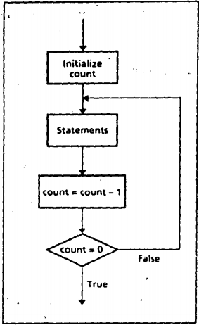
FOR LOOP
The control is transferred to destination_label until CX becomes 0.
A FOR LOOP can be implemented using the LOOP instruction:
TOP:
;initialize CX to loop_count
;body of the loop
LOOP TOP

Slide 4
FOR LOOP-Example
Write a count-controlled loop to display a row of 80 stars:
FOR 80 times DO
display ‘*’
END_FOR
MOV CX,0
MOV AH,2
MOV DL, '*'
TOP:
INT 21H
LOOP TOP

Slide 5

Lab Tasks
Task: 1
Write an assembly probram to print all the ASCII code from 0 to 255. Hints: use jnz and dec instructions
Sample Output

Slide 6
Lab Tasks
Task: 2
Put the sum of the first 50 terms of the arithmetic sequence
I, 5, 9, 13, ... in DX. Hints: Employ LOOP instructions to do the following.
first we find how many loops needed:
(last term – first term )/ difference
(148 – 1)/3 = 49 loops
So put cx = 49

Slide 7
Lab Tasks
Task: 3
Put the sum 100 + 95 + 90 + ... + 5 in AX. Hints: Employ LOOP instructions to do the following.
first we find how many loops needed:
(last term – first term )/ difference
(100 – 5)/5 = 19 loops
So put cx = 19

Slide 8
Lab Tasks
Task: 4
Read a character and display it 50 times on the next line. Hints: use LOOP instructions and put cx = 50
Sample Output
Enter a character: d
Dddddddddddddddddddddddddddddddddddddddddddddddddd
Thank you.

Slide 9
Lab Tasks
Task: 5
Write a program to display a "?", read two capital letters, and display them on the next line In alphabetical order. Hints: use cmp, jg, xchg
Sample Output
Enter character: CB
BC
Thank you.

Slide 10
Books
Assembly Language Programing and Organization of the IBM PC
Ytha Yu
Charles Marut

Slide 11
References

